Slide 1
AE sound editing tricks

Slide 2
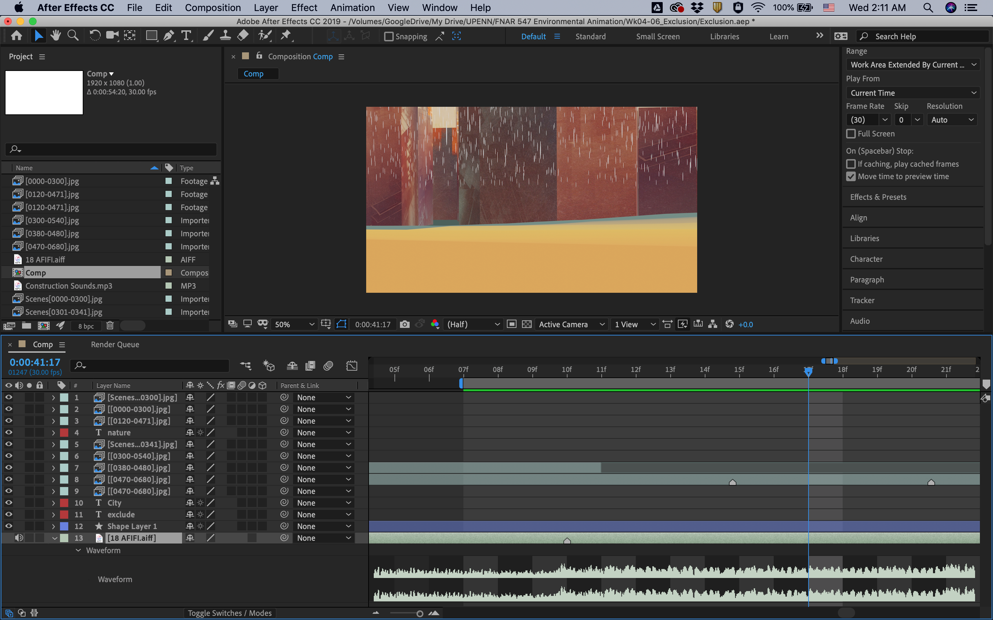
LL: expanding audio waveform
+/-: zoom in/ out

Slide 3
[Win] * (num pad): place a marker
[Mac] Ctrl + 8: place a marker

Slide 4
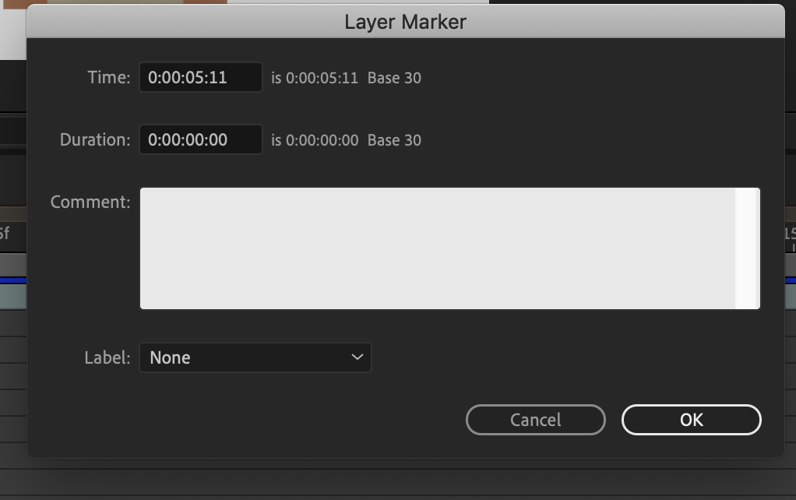
[Win] alt + * (num pad): layer marker windows
[Mac] opt + ctrl + 8

Slide 5
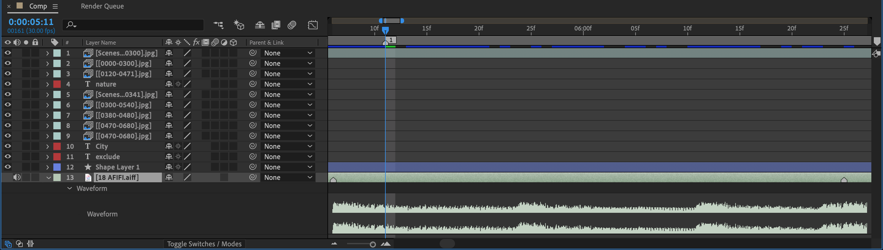
shift + 1/2/3/…: number marker on the time line
Press their numbers to jump to numbered segments

Slide 6
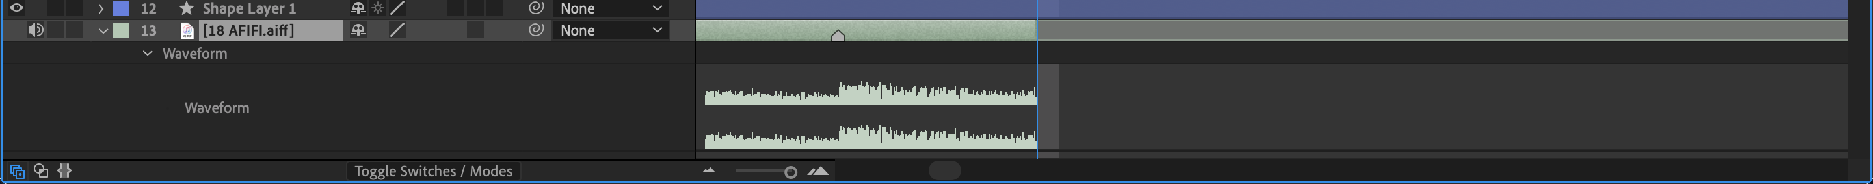
[Win] Alt + ]: trim off temporarily
[Mac] opt + ]

Slide 7
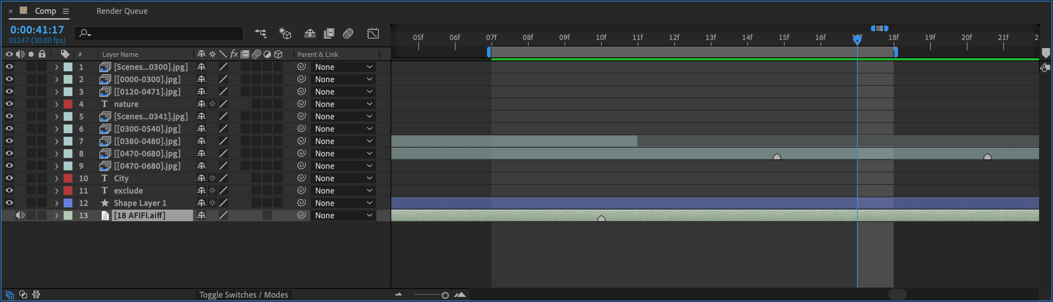
B: beginning of working area
N: end of working area

Slide 8
[Win]:
[Mac] ctrl + 0: play from beginning

Slide 9
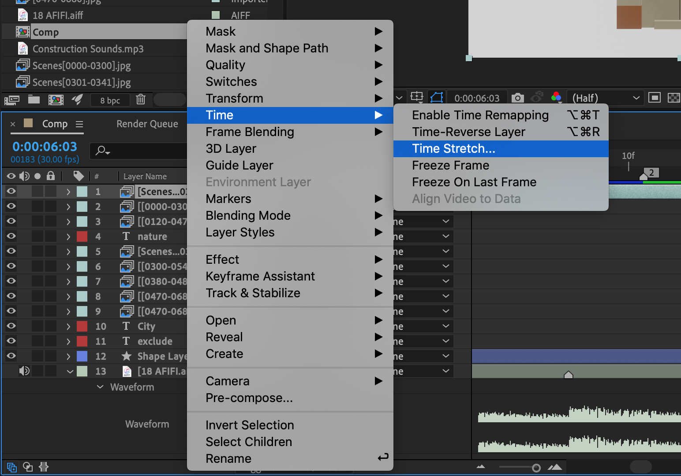
Stretching speed by 50: double the speed

Slide 10
J & K: jump back and forth to the markers including keyframes

Slide 11
Thank you

